Slide 1
Writing an Operationalised hypothesis and differentiating between research
Learning Intentions
I will be able to write an operationalised hypothesis
I will be able to tell the difference between:
Scientific v Non-Scientific
Experimental v Non-Experimental

Slide 2
Quick Fire Quiz!
In what type of research is an IV and DV used?
Which variable is changed and manipulated by the researcher?
Which variable is measured by the researcher?
What is th ename of ANY variable why may impact the results of a study?
What does the term operationalise mean? What is the minimum amount of conditions / groups that an experiment needs?
What is the name of the condition / group that receives the IV?
What is the name of the condition / group that does not receive the IV?
Partner up
Take it in turns to ask and answer the questions to the right
If you are asking the questions, feel free to give the person clues
If you are answering try at first to not use your notes

Slide 3
Recap
IV and DV are used to show cause and effect. They are used in experimental research
Independent Variable (IV) – changed / manipulated by researcher
Dependant Variable (DV) - measured by researcher
Extraneous Variable (EV) – may impact DV of experiment
Operationalise – to make a variable testable and measurable
An experiment has at least 2 conditions –
Experimental condition – participants receive IV
Control condition/group – participants do not receive IV

Slide 4
Operationalizing hypothesis
Both IV and DV must be operationalised by being given specific or measurable values.
Operationalised hypothesis recipe:
It is hypothesized that;
Population + IV + DV + How DV is measured
+ Compared to Control group (no IV)
New Vocabulary!
Population: AKA Target population is the section of individuals from the wider population that the researchers are interested in collecting data on.
e.g. teenage boys between 13- 19 or FIFO workers or women between the ages of 30 – 45 years old

Slide 5
Good Operational Hypothesis example
It is hypothesized that Victorian drivers aged 18 – 25 who have smoked marijuana (smoking one joint containing 500 milligrams of marijuana 20 minutes before taking a driving test) will perform worse on a driving test as measured by the % score on the VIC roads “Are you Road Ready?” driving simulator compared to participant's who have not smoked marijuana
Write this in your notes and highlight the population, the IV, the DV and the control group
Notes:
Write it out and highlight and annotate the IV, DV, how the DV is measured, sample, control group

Slide 6
TASK: Practice making operationalized hypotheses
Write 3 x operationalised hypotheses in your book
Caffeine (IV), Sports performance (DV), Year 7’s (Population)
Alcohol (IV), Bad Decisions (DV), (You choose a population)
Childhood trauma (IV), (You choose the DV), 25 year old females (population)
Remember to use your recipe! – this should be in your book already.

Slide 7
Learning Intentions
I will be able to discriminated between Scientific and Non-Scientific and experimental and non-experimental
I will be able to outline and evaluate data collection methods and different data types

Slide 8
What do you understand of the scientific method? What does it mean to be scientific?

Slide 9
Characteristics
Knowledge
Scientific
Measurable
Follows scientific method
Non-Scientific
All other ways of knowing
Testable

Slide 10
Psychology Research - Terminology
Vocabulary
Terminology: the body of terms used with a particular technical application in a subject of study, profession method: a particular and systematic way of approaching something systematic: set/ regular/ methodical/ organised manner empirical evidence: based on or verifiable by observation/experience rather than on a theory or pure logic
Scientific method:
A research method that is common to all sciences (including chemistry, physics, biology, etc.)
Involves a systematic approach to planning, conducting and reporting research, usually in the form of experiments.
Researchers collect empirical evidence or data that enable them to draw valid conclusions (based on the experiments)
Non-scientific approaches:
Are not based on science/do not have any scientific foundation
Do not involve the scientific method and are not based on empirical evidence
Includes studies such as astrology (theories/beliefs that the movement of the stars can predict our personality and behaviour), numerology (using numbers to predict future events), and graphology (interpreting handwriting to describe personality and behaviour)
Also includes faith and religion, common sense, personal and popular beliefs
Concept Development
Checking for understanding
What makes psychological research valid? What is astrology and why is it not considered a scientific approach to understanding personality and behaviour? What is the difference between scientific and non-scientific approaches?

Slide 11


Slide 12
what ARE SOME KEY DIFFERENCES BETWEEN NON-EXPERIMENTAL AND EXPERIMENTAL RESEARCH?

Slide 13
Knowledge
Scientific
Non-Scientific
Experimental research
Non-experimental
research

Slide 14
Characteristics of experimental and non-experimental research
Experimental
Manipulation of IV, Measuring DV =
Cause and Effect
Control of as many extraneous variables =
High Reliability, Lower validity
Non-experimental
No manipulation of IV =
Correlation
Looks at relationship between behavioral variables
Usually takes place in natural setting with low control over extraneous variables =
Low reliability, Higher Validity

Slide 15
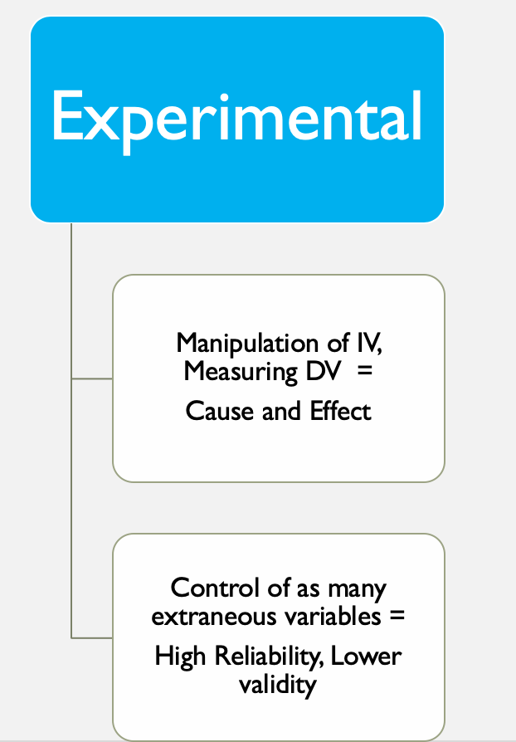
Experimental research
Has ATLEAST two groups
Experimental group(s) – receives IV
Control group – does NOT receive IV

Slide 16
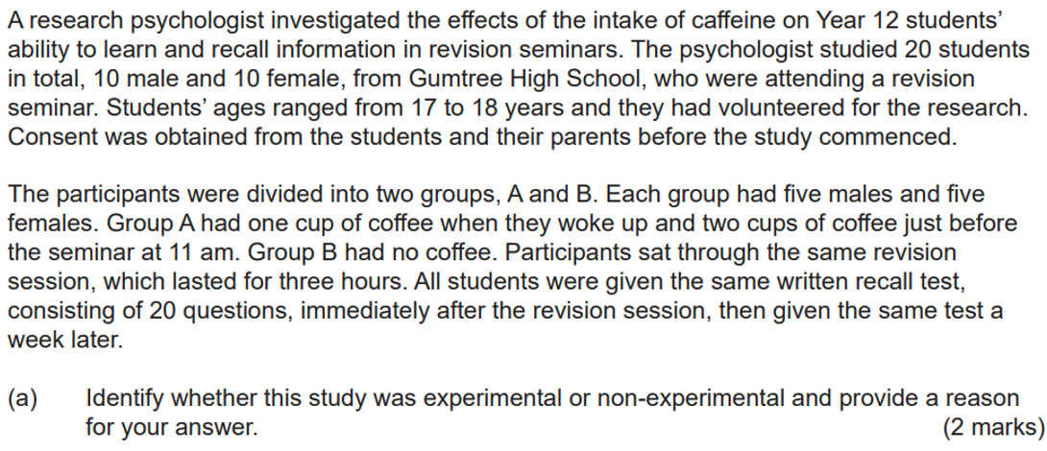

Slide 17
Define: objective Subjective qualitative Quantitative

Slide 18

Describing data
Subjective
information from the subjects point of view including feelings, perceptions, and concerns obtained through interviews.
Objective
observable and measurable data obtained through observation, physical examination, and laboratory and diagnostic testing.
Concept Development
Advantages:
Can study the meaning behind behaviour
Disadvantages:
Can be bias or open to interpretation
Advantages:
Highlight reliable results
Disadvantages:
Not all data can be measured objectively
Check for understanding
What are the definitions of subjective and objective data

Slide 19
Subjective or Objective:
Heart rate monitor
Personality tests
Thermometer reading
Brain Scan
Reaction time
Observation by researcher
Diagnosis of mental illness

Slide 20
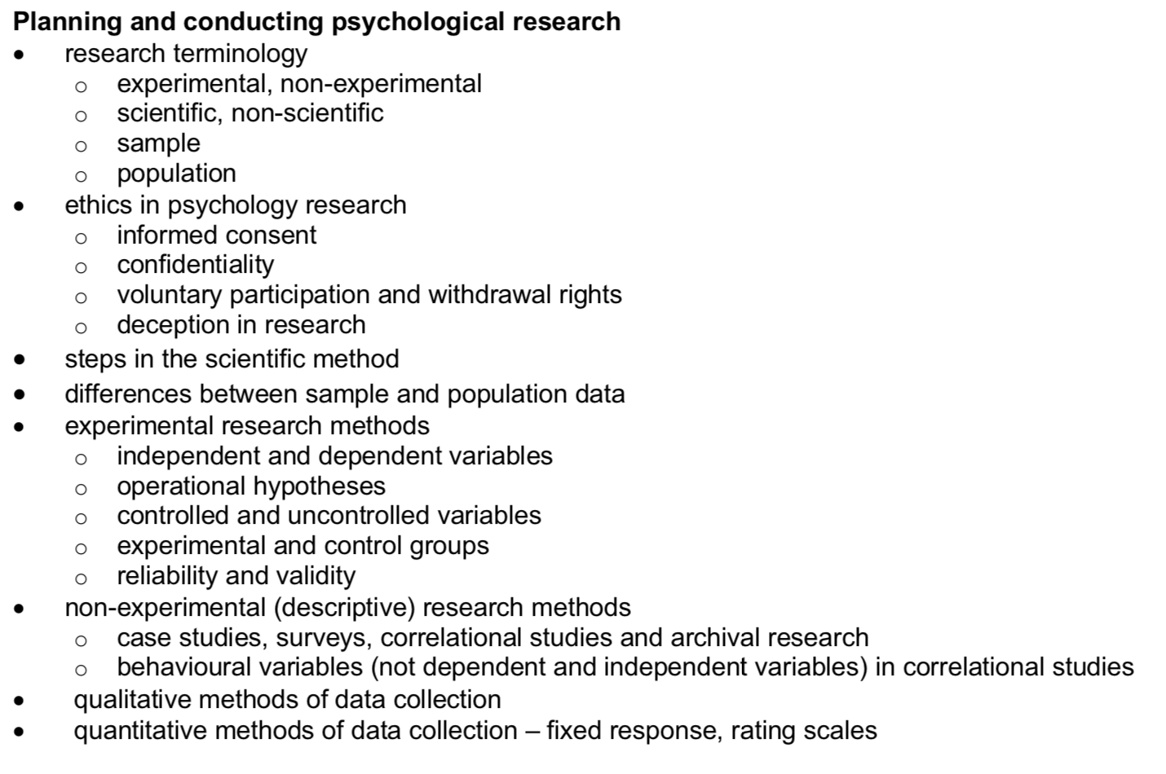
Quantitative
Vocabulary
Physiological readings: Heart rate monitor, blood pressure measure, breathing rate etc. Inferential:
Any form of data collected in numeric variables (e.g. how many; how much; or how often).
Concept Development
Purpose | Question | Data | Analysis | Final Report
To examine the relationship between variables | How much? To what extent? How often? In the form of a hypothesis | Numeric scores From instruments | Descriptive and inferential statistics Visually represented: graphs | More rigid / formal
Advantages:
Easy / quick to analyse
No interpretation
Disadvantages:
Reductionist – does not look at meaning usualy

Slide 21
Qualitative
This type of research "refers to the meanings, concepts, definitions, characteristics, metaphors, symbols, and description of things".
Concept Development
Purpose | Question | Data | Analysis | Final Report
Explores the meaning behind experience | Exploratory in nature No hypothesis Called a Research Question | Data collected and recorded through words and language | Data analysed and organized into themes. | Narrative based Open to interpretation Lots of writing
Advantages:
Very descriptive and rich data
Disadvantages:
Can be more open to interpretation by researcher

Slide 22
How would a researcher collect Objective qualitative data: Objective Quantitative data: Subjective Qualitative data: Subjective Quantitative data: thinking strategy: if you are unsure – define the terms then try to figure it out

Slide 23
Different data collection methods collect different types of data.
Subjective Qualitative
Data collection method:
Observations that are descriptive
Open-ended questions in interviews
Open-ended questions in surveys
Objective Quantitative
Data collection method:
Counting observable behaviors “amount of hits” “how many times a baby signals for its mum”
Physiological measures: heart rate, reaction time, stress hormone in blood sample, heart rate
Objective Qualitative
Data collection method:
Brain scans that show images
Observations that are from multiple researchers / medical professionals
Subjective Quantitative
Data collection method:
Fixed response questions (yes, no, maybe) on a survey or in an interview
Likert scales on a survey

Slide 24
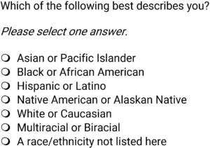
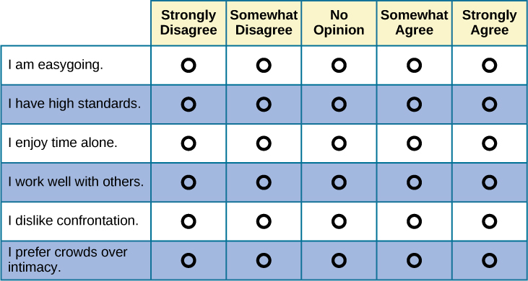
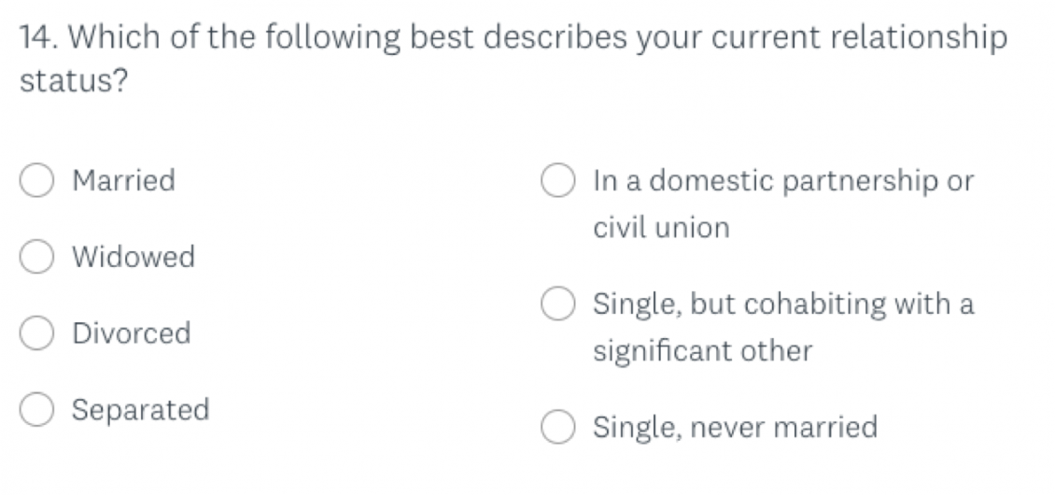
Example of fixed response:
The idea is that an individual can only pick one response and then they are tallied according to their responses
Examples of a likert-scale:
Usually on a numeric scale (1-10, 1-5) or on a scale from strongly disagree to strongly agree. Participants are only able to respond on the scale and their responses are tallied as numeric responses.

Slide 25
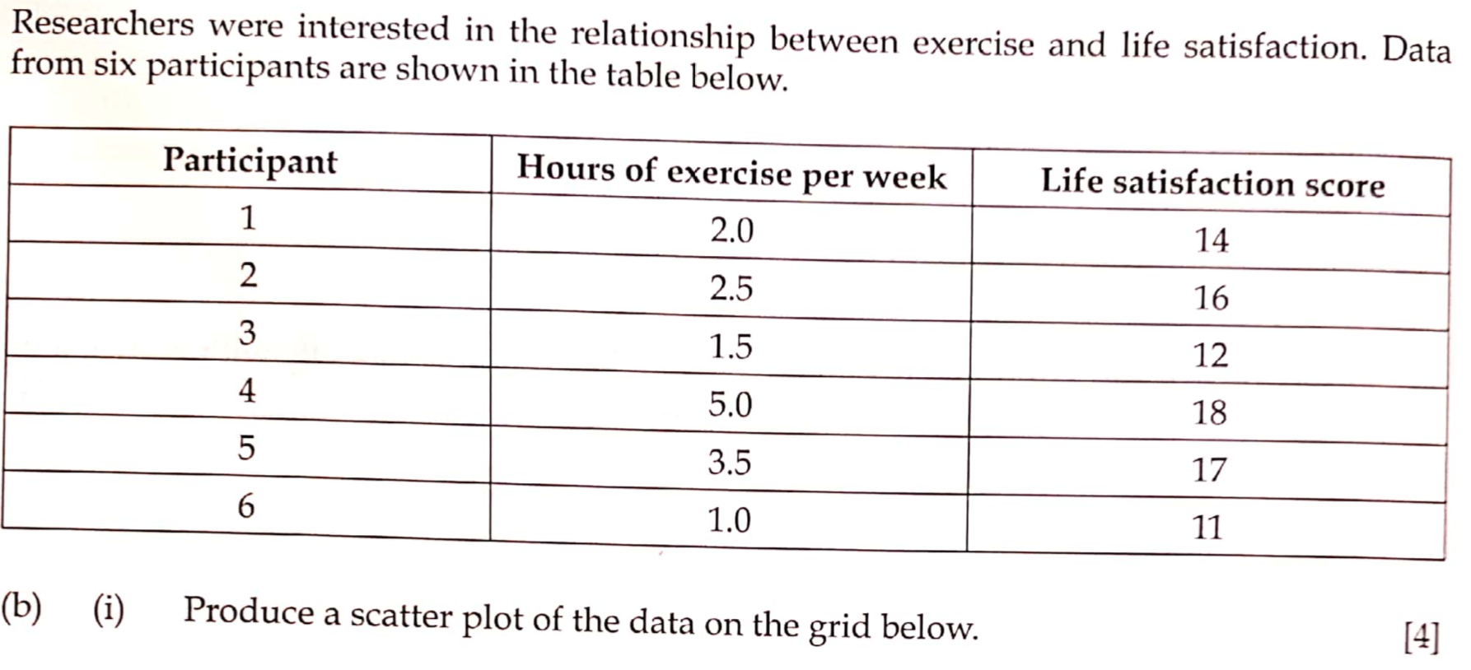

Slide 26
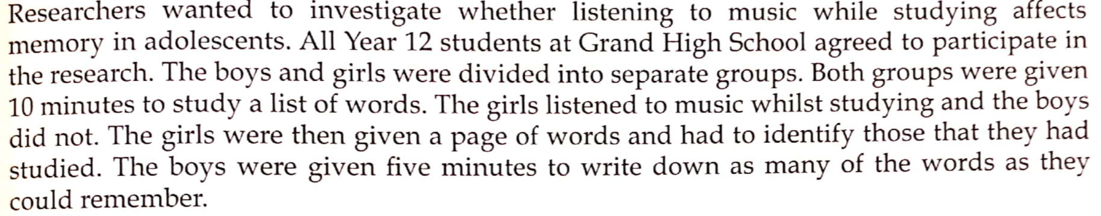

Slide 27
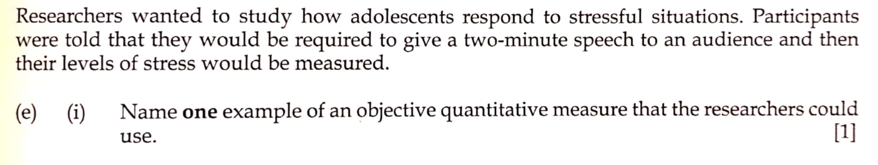

Slide 28
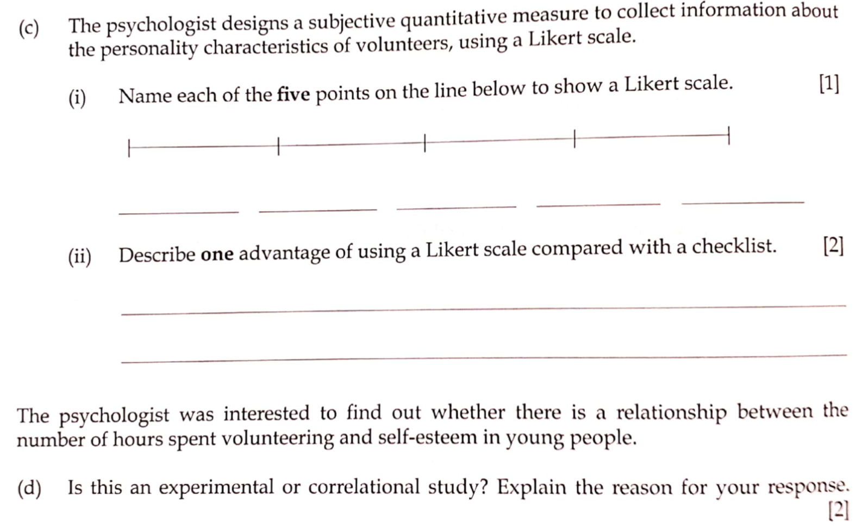
2014

